Slide 1

Data conversion

Slide 2

Objectives
At the end of the lesson students should be able to
convert decimal numbers into Octal, binary and hexadecimal numbers.
convert binary numbers into octal, decimal and hexadecimal numbers.
convert hexadecimal numbers into octal, decimal and binary numbers

Slide 3
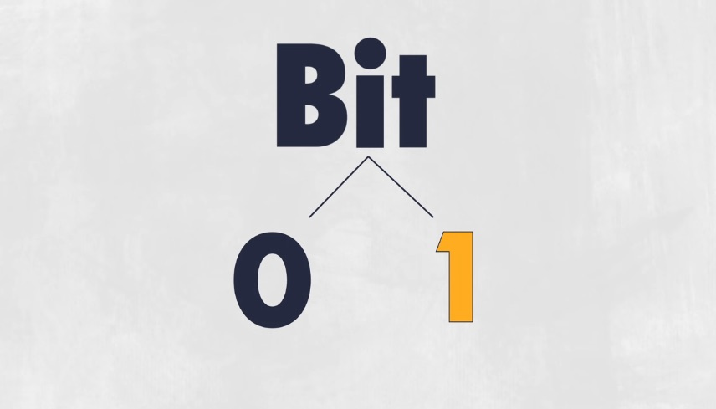
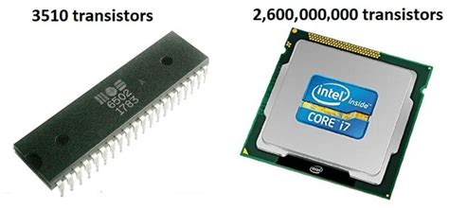
How the computer stores data?
To understand fully the way a computer store and process data, it is important to know how a computer represents this data.
Computers are digital because they can only recognize two states on and off because they are
electronic devices powered by electricity and work by using pulses of voltage.
The circuits in a computer's processor are made up of billions of transistors.
Transistors are microscopic (tiny) switches that is activated by the electronic signals it receives in the form of on and off signals.

Slide 4
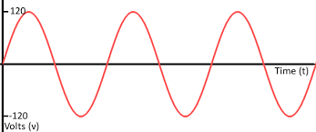
What is Data Representations?
Data Representation refers to the way in which this unprocessed data is stored, processed, and transmitted.
Data can be represented in two ways.
Analogue Data
Digital data
Analogue data uses continues waves form that varies in strength and quality.

Slide 5
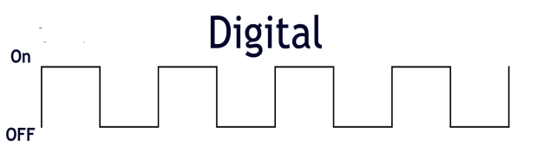
What is Data Representations?
Computers on the other hand cannot process analogue data.
They are only capable of processing digital data.
Question?
Why does computer only process digital data.

Slide 6
Why does the computer only process digital data?
The computer is a collection of electronic circuits which is made up billions of transistors that use electricity in the form of pulse of voltage.
Transistors are microscopic (tiny) switches that is activated by the electronic signals (pulse of voltage) it receives in the form of on and off signals.
These signals are represented using 0 and 1.
The digit (0) zero represents the electronic state of ‘off’ (absence of an electronic charge/voltage). When an current doesn't pass through (the switch is open), this represents a 0.
The digit (1) one represents the electronic state of on (present of an electronic charge/voltage). If a current passes through the transistor (the switch is closed), this represents a 1.
Question: In pairs describe how a light blub would explain the electronic signal discussed above

Slide 7

How the computer stores data?
The two states of the transistor is often referred to as Binary.
All data that is processed by a computer must be stored as binary. A translation is done on the data that human put into computer such as numbers, text, photos, sound, and video to binary code.
The computer uses the binary system to process data. Every character, number, text ect is stored in the computer as a bit (short for binary digit). It is either 0 or 1
A bit is the smallest unit of data a computer can represent. A bit by itself a bit is not very informative
For the computer to be able to store or process any form of data in the computer the bits must be combined in 8 bits together to form a unit. This is called a byte.

Slide 8
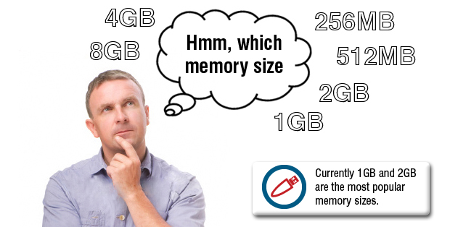
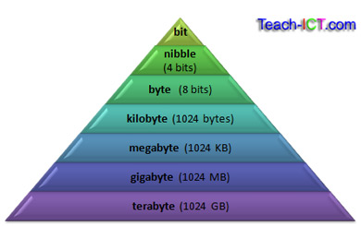
How the computer stores data?
The number of instructions the computer can store in its memory is measured in bytes.
A byte is a combination of 8 bits.
To represent a single character on the computer the processors has to combine 8 bits together, making up a byte
Computer memory is measured in terms of how many bits it can store.
2⁷ can be represented in a computer

Slide 9
Data Storage
Data Quantity | In Bytes
4 bits | 1 Nibble
2 nibbles | 1 byte
8 bits | 1 bytes
Kilobyte | 1,024
Megabyte | 1,048,576
Gigabyte | 1,073,741,824
Terabyte | 1,099,511,627,776
Petabyte | 1,125,899,906,842,624
Exabyte | 1,152,921,504,606,846,976
Zettabyte | 1,180,591,620,717,411,303,424
Yottabyte | 1,208,925,819,614,629,174,706,176

Slide 10
Representation of Computer Storage
When computer scientists used the word kilobyte (kB) they mean 1024 bytes.
It has become a common practice to use the decimal system to refer to storage, therefore instead of 1024 bytes the equivalent of 1000 bytes is used.
There are two standards that is used to describe storage
Binary (1024 bytes) IEC- International Electrotechnical Commission
Decimal (1000 bytes) (SI –International system of unit)
Both standards can be used but as data quantities grows, there is a big discrepancy between them is evident.
Thought teaser. Why do you think this is so?

Slide 11
Representation of Computer Storage
To address this discrepancy in 1998 the International Electrotechnical Commission (IEC) and other regulatory organizations banded together to create a new set of prefixes to be used for information storage
The perfix Kibi, mebi, gibi, tebi, pebi and exbi were adopted so as to eliminate the confusion that sometimes occurs between decimal (power of 10) and binary (power of 2) numeration terms.
Full technical name | Prefix | Symbol | Value
Kilobinary | kibi | Ki | 2¹⁰=1,024
megabinary | mebi | Mi | 2²⁰=1,048,576
gigabinary | gibi | Gi | 2³⁰=1,073,741,824
terabinary | tebi | Ti | 2⁴⁰=1,099,511,627,776
petabinary | pebi | Pi | 2⁵⁰=1,125,899,906,842,624
exabinary | exbi | Ei | 2⁶⁰=1,152,921,504,606,846,97

Slide 12
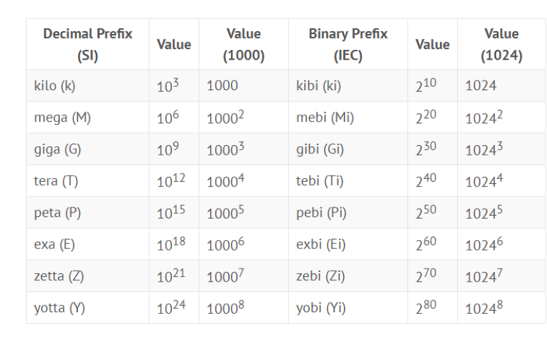
Comparison of Data Storage

Slide 13
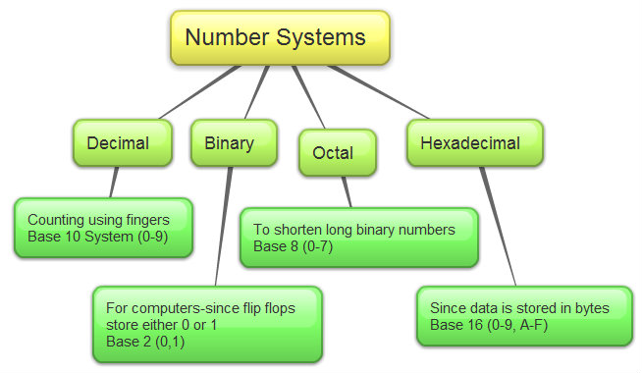
The Number System
Computer architecture supports following number systems.
Binary number system
Octal number system
Decimal number system
Hexadecimal (hex) number system

Slide 14
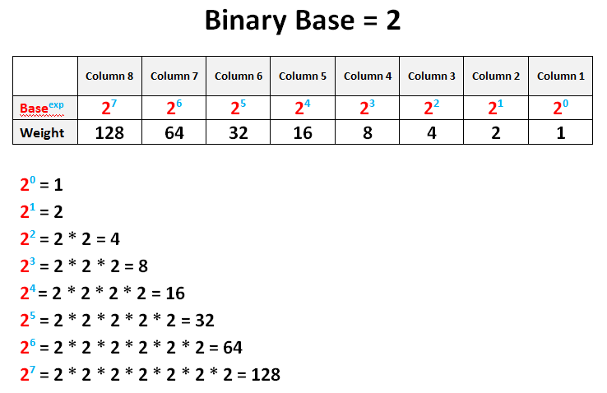
A Binary number system has only two digits 0 and 1. Every number (value) is represented with 0 and 1 in this number system. The base of binary number system is 2, because it has only two digits. Binary number system is also positional value system, where each digit has a value expressed in powers of 2
Binary System
2⁷ | 2⁶ | 2⁵ | 2⁴ | 2³ | 2² | 2¹ | 2⁰
128 | 64 | 32 | 16 | 8 | 4 | 2 | 1

Slide 15
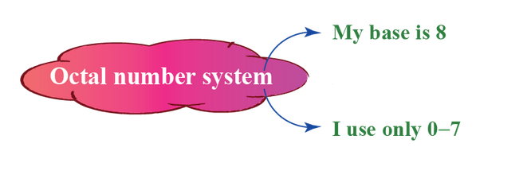
Octal number system has only eight (8) digits from 0 to 7. Every number (value) represents with 0,1,2,3,4,5,6 and 7 in this number system. The base of octal number system is 8, because it has only 8 digits. n octal numbering system we represent the binary numbers as a set of 3 digits (2³= 8)
Octal number system
8⁴ | 8³ | 8² | 8¹ | 8⁰
4096 | 512 | 64 | 8 | 1

Slide 16
Decimal number system
Decimal number system has only ten (10) digits from 0 to 9. Every number (value) represents with 0,1,2,3,4,5,6, 7,8 and 9 in this number system. The base of decimal number system is 10, because it has only 10 digits.
Each digit has a value based on its position called place value. The value of the position increases by 10 times as we move from right to left in the number.
10⁵ | 10⁴ | 10³ | 10² | 10¹ | 10⁰
100,000 | 10,000 | 1,000 | 100 | 10 | 1
For example, the value of 786 is
= 7 x 10² + 8 x 10¹ + 6 x 10⁰
= 700 + 80 + 6

Slide 17
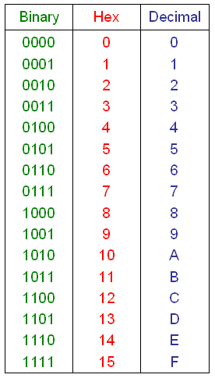
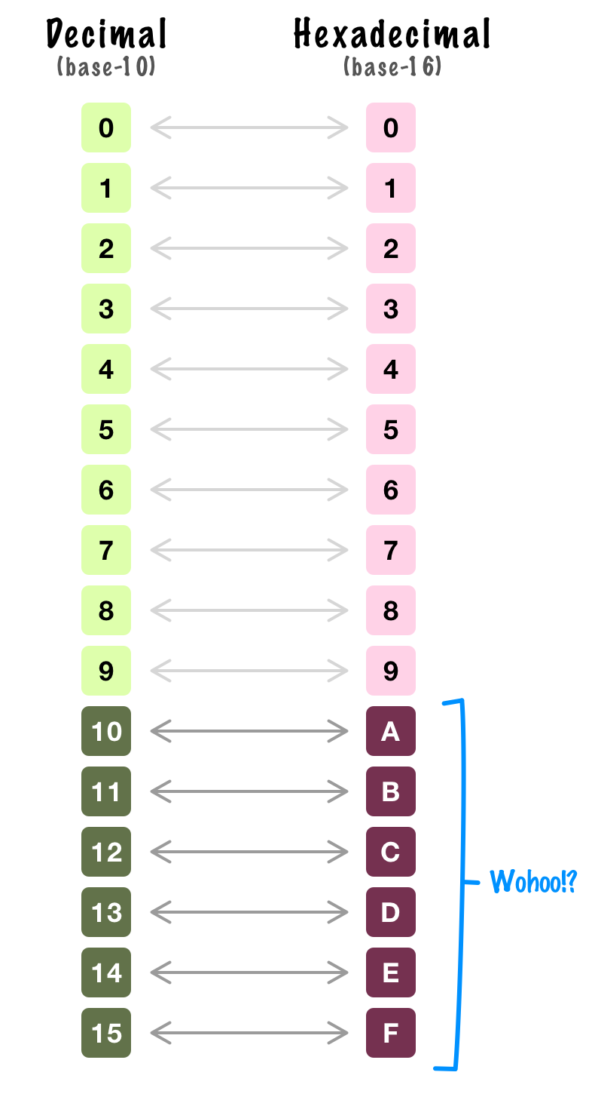
Hexadecimal number system
A Hexadecimal number system has sixteen (16) alphanumeric values from 0 to 9 and A to F.
Every number (value) represents with 0,1,2,3,4,5,6, 7,8,9,A,B,C,D,E and F in this number system.
The base of hexadecimal number system is 16, because it has 16 alphanumeric values.
A is 10, B is 11, C is 12, D is 13, E is 14 and F is 15.

Slide 18
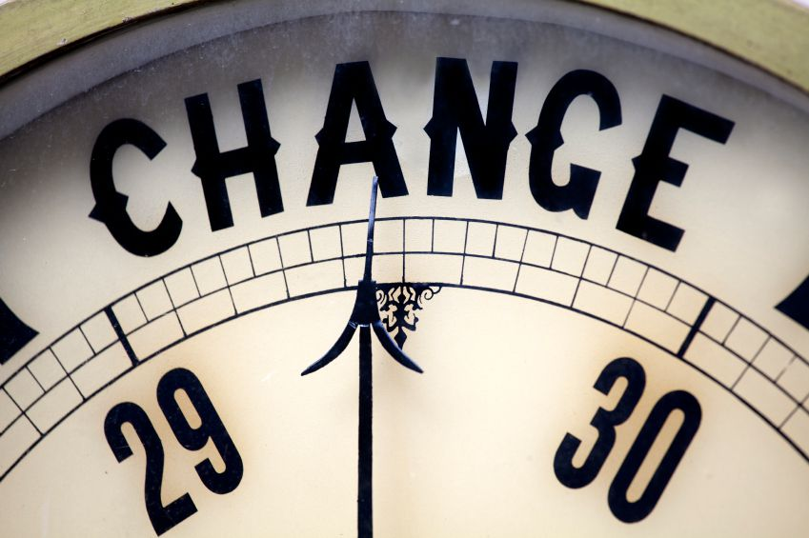
Conversion

Slide 19

Binary Conversion

Slide 20
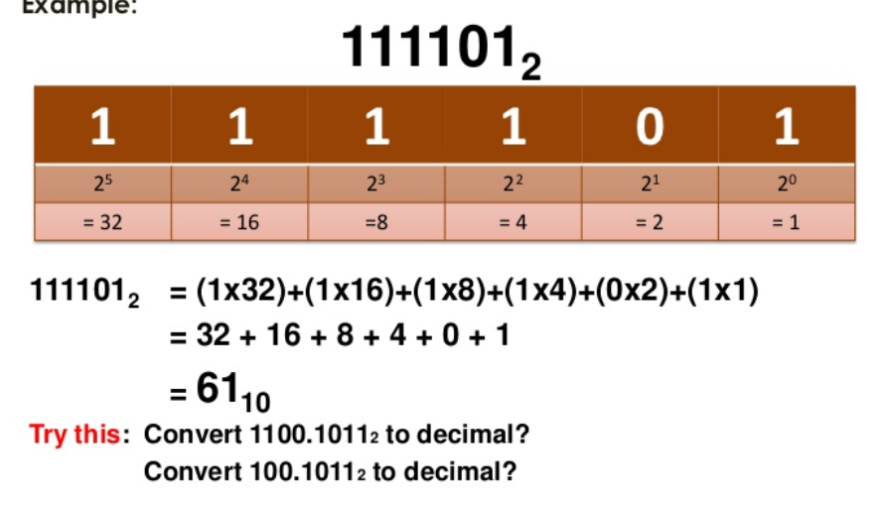
Binary to Decimal (denary)
Place value and add method
Convert 011010₂ to Decimal (denary)
2⁵ | 2⁴ | 2³ | 2² | 2¹ | 2⁰
32 | 16 | 8 | 4 | 2 | 1
0 | 1 | 1 | 0 | 1 | 0
0 + | 16+ | 8+ | 0+ | 2+ | 0
16 + 8 + 2 =26
011010₂ = 26₁₀

Slide 21
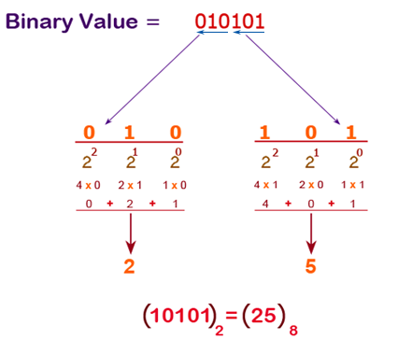
Binary to Octal
8 = 2³
Each group of 3 bits represents an octal digit
Divide the binary digits into groups of three (starting from right) for integer part.
Convert each group of three binary digits to one octal digit.
110101011₂
Step 1. Divide into groups of 3 110 101 011
Step 2. Convert each group into one octal digit 6 5 3 = 653₈

Slide 22
Binary to Hexadecimal
Divide each group into 4 bits represents a hexadecimal digit
Convert each group of binary digits to one hexadecimal digit.
Convert Binary to hex
10101001
1010 1001
8+2 8 + 1
9
A 9 =A9

Slide 23
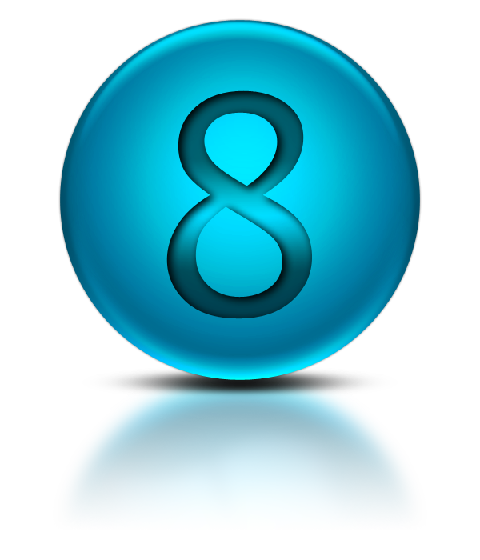
OCTAL

Slide 24
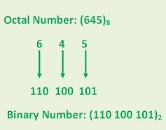
Converting Octal to Binary
Represent each number to its binary equivalent.
Then combine the groups

Slide 25
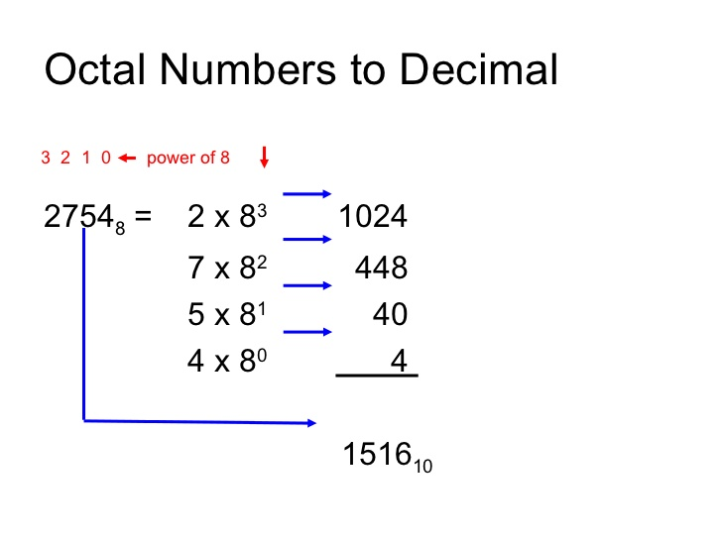
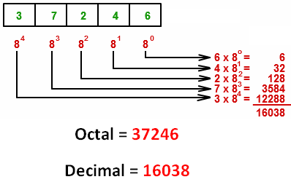
Octal to Decimal
8³ | 8² | 8¹ | 8⁰
512 | 64 | 8 | 1
5 | 3 | 2 | 6
2560+ | 192+ | 16+ | 6

Slide 26
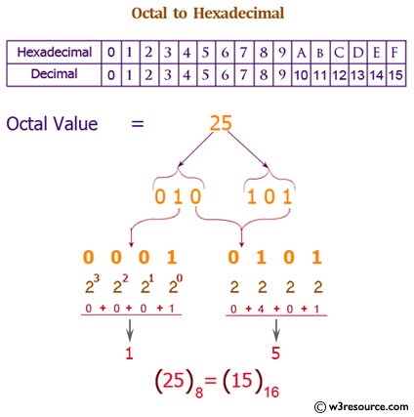
Octal to Hexadecimal
First you have to write all the octal digits
And then write binary equivalent of each octal digit one by one in 3-3 binary pair
Then combine all the binary pairs. Now make 4-4 binary pair
Write decimal equivalent of each binary pair
1 4 5 2 (write all octal digits)
001 100 101 010 (write its binary equivalent)
001100101010 (combine all binary digits)
0011 0010 1010 (make 4-4 binary pair)
3 2 10 (write decimal equivalent of each binary pair)
3 2 A (convert digit 10 to 15 into character A to F)
=32A

Slide 27

Decimal Conversion

Slide 28


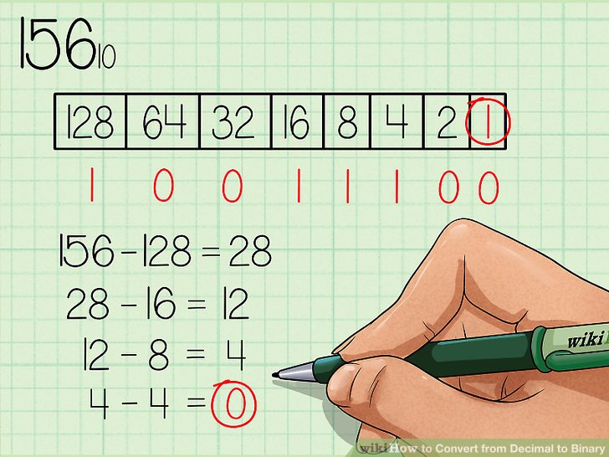
Convert Decimal to Binary
Descending Powers of Two and Subtraction
Double Dabble Method
The most popular way to convert a decimal number into the binary. The decimal number is progressively divided by 2 and the remainder is written after each division.
The remainder is written from the bottom up
Division | Remainder (R)
156 / 2 = 78 | 0
78 / 2 = 39 | 0
39 / 2 = 19 | 1
19 / 2 = 9 | 1
9 / 2 = 4 | 1
4 / 2 = 2 | 0
2 / 2 = 1 | 0
1 / 2 = 0 | 1
156₁₀ this will be 10011100₂

Slide 29
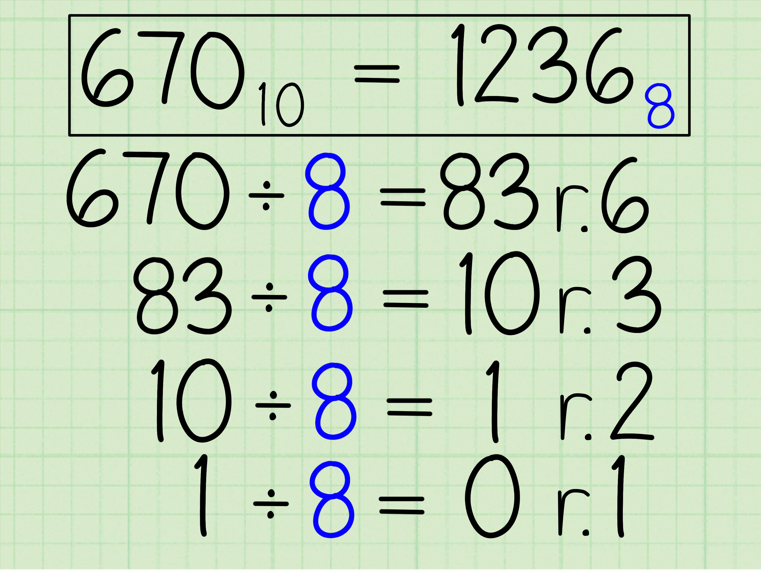
Decimal to Octal
Convert decimal number 98 into Octal number.
First convert it into binary,
= (98)₁₀ =(1100010)₂
Then convert each group of 3 bits in binary number.
= (001 100 010)₂ = (001 100 010)₂
= (1 4 2)₈
= (142)₈

Slide 30
Convert Decimal to Hex
Convert decimal number 540 into hexadecimal number.
Convert decimal number 105 into hexadecimal number.
Convert (960)₁₀ into hexadecimal.
Step 1 First, divide 960 by 16.
960 ÷ 16 = 60 and remainder = 0
Step 2 divide quotient 60 by 16.
60 ÷ 16 = 3 and remainder 12.
Step 3 divide 3 by 16, will leave quotient=0 and remainder = 3.
Step 4 Write the reminder in reverse order
Step 5 Substituting the equivalent hexadecimal value for them,
3→3, 12→C and 0→0
Therefore, (960)₁₀ = (3C0)₁₆
First convert it into binary
= (100)₁₀ = 1100100 ₂
Then convert to hexadecimal by use grouping of 4 bit of binary number.
= (1100100)₂ = (0110 0100)₂
= (64)₁₆

Slide 31

Hexadecimal Conversion

Slide 32
Hexadecimal to Binary
Convert A2B₁₆ to an equivalent binary number.
First, convert the given hexadecimal to the equivalent in decimal value.
A 2 B
2 11
Next write the equivalent binary for each
10 2 11
1010 0010 1011
Combine all 101000101011₂
A9
A=10 9
1010 1001
A9 = 10101001

Slide 33
Hexadecimal to Decimal
A 9
16¹ 16⁰
10 * 16¹ + 9 *16⁰
160 + 9
169
Convert hexadecimal number F1 into decimal number.
First convert it into binary,
= (F1)16 = (1111 0001)2
Because in binary, value of F and 1 are 1111 and 0001 respectively.
Then convert it into decimal number multiplying power of its position of base.
= (1x2⁷+1x2⁶+1x2⁵+1x2⁴+0x2³+0x2²+0x2¹+1x2⁰)₁₀
(241)₁₀
16¹ | 16⁰
16 | 1
A=10 | 9
16 * 10 | 1 * 9
160 + 9

Slide 34
Hexadecimal to Octal
Convert 1BC₁₆
1BC₁₆
1 B C
1 11 12
0001 1011 1100 = 000110111100
Now group them from right to left, each having 3 digits.
000, 110, 111, 100
000→0, 110 →6, 111→7, 100→4
Hence, 1BC₁₆ = 674₈
1 | B | C
1 | 11 | 12
0001 | 1011 | 1100
000110111100
000 110 111 100
0 6 7 4
6 7 4 ₈

Slide 35

Worksheet Practice

